Slide 1
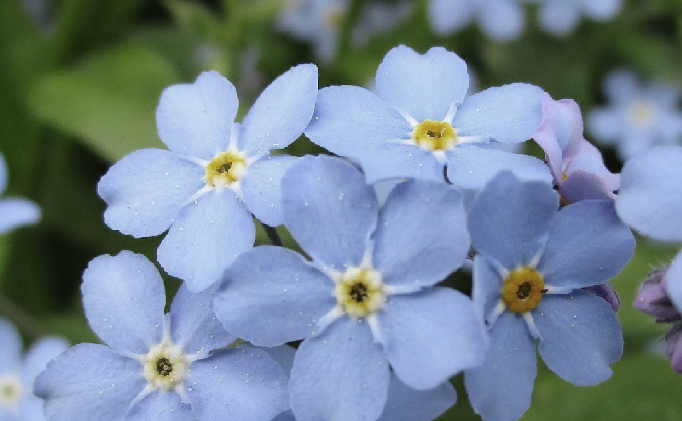



The Alaska Community Foundation
AFFILIATE
PROGRAM

Slide 2
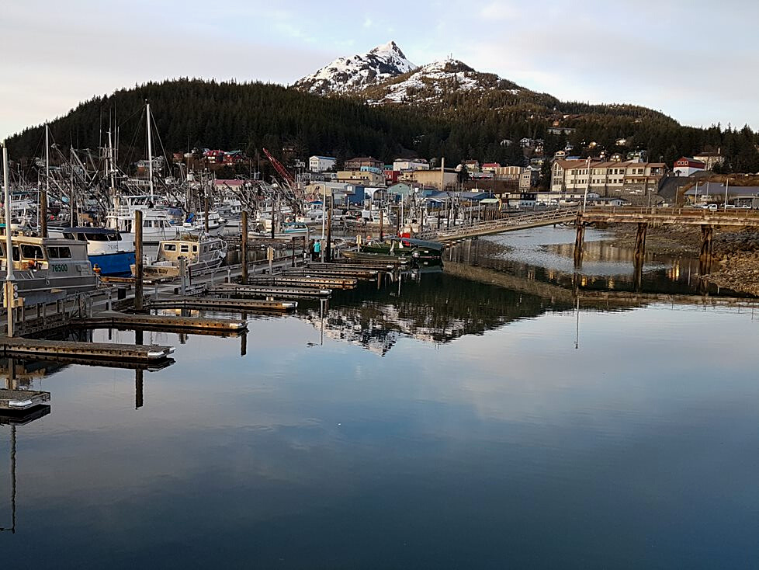


Cordova Community Foundation

Slide 3
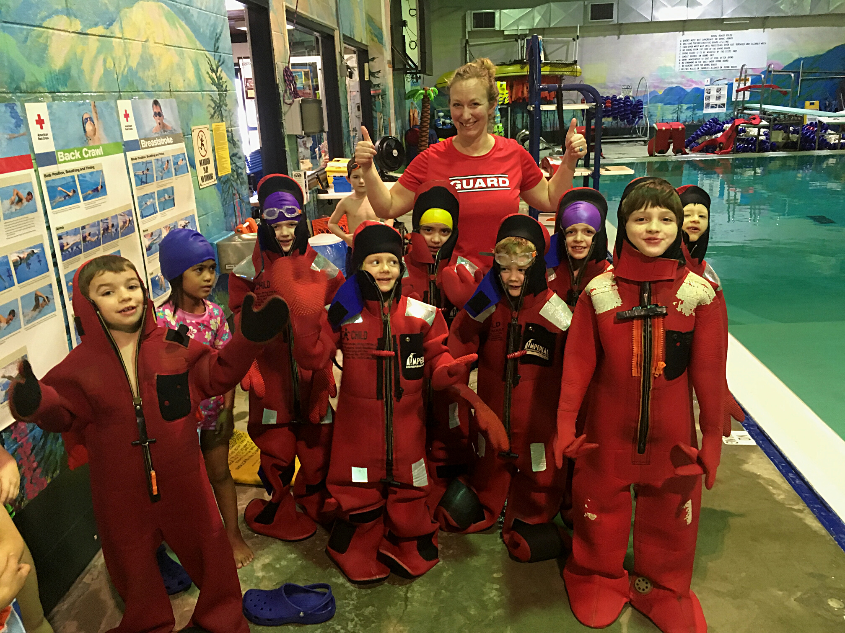

Cordova Community Foundation

Slide 4
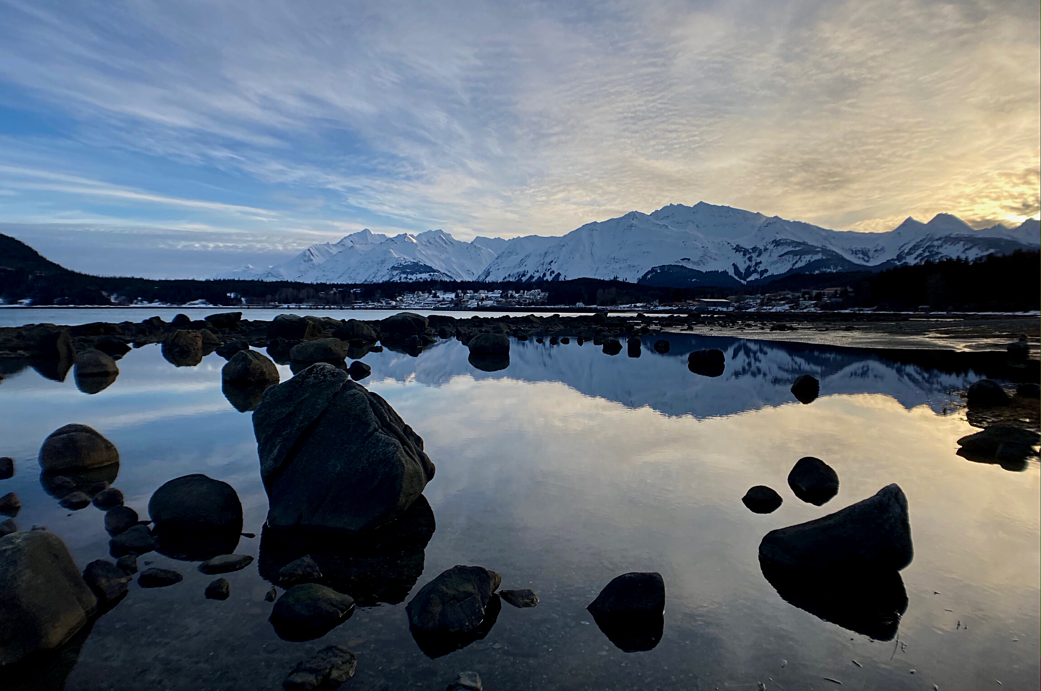
Chilkat Valley Community Foundation

Slide 5
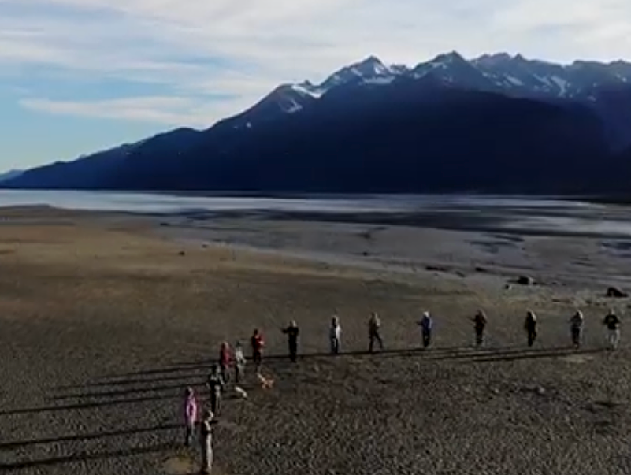

Chilkat Valley Community Foundation

Slide 6
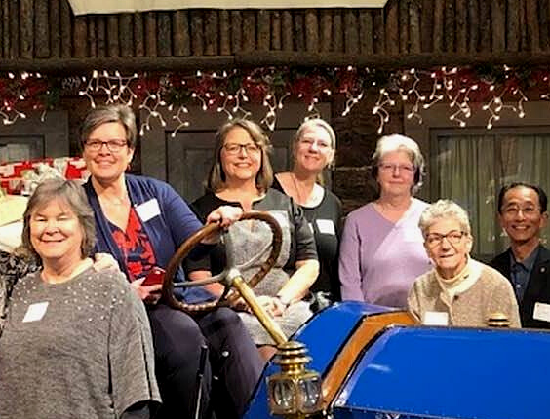
Golden Heart Community Foundation

Slide 7
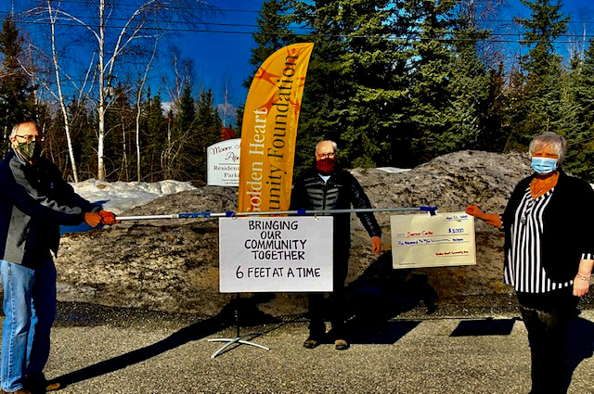

Golden Heart Community Foundation

Slide 8
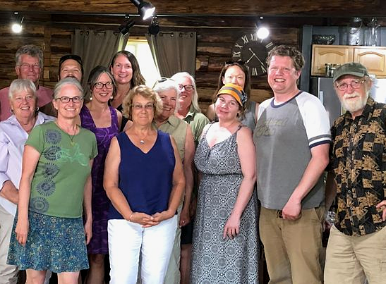

Jessica Stevens Community Foundation

Slide 9
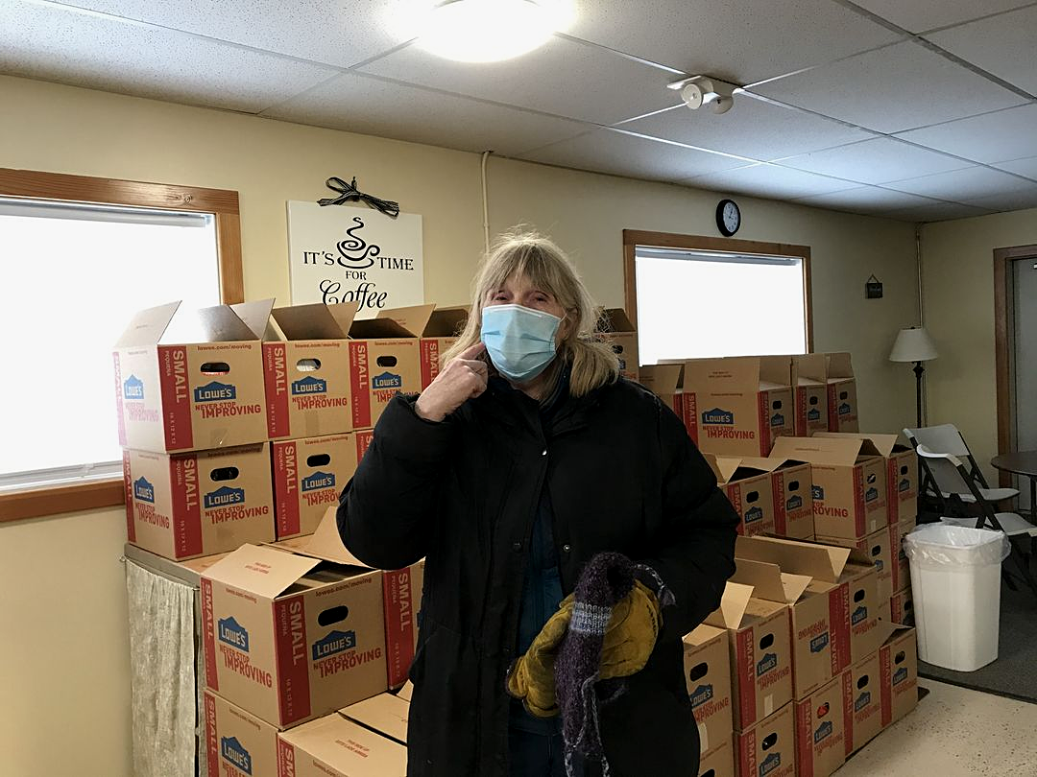
Jessica Stevens Community Foundation

Slide 10
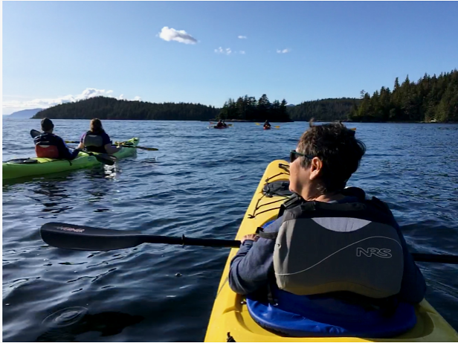

Ketchikan Community Foundation

Slide 11
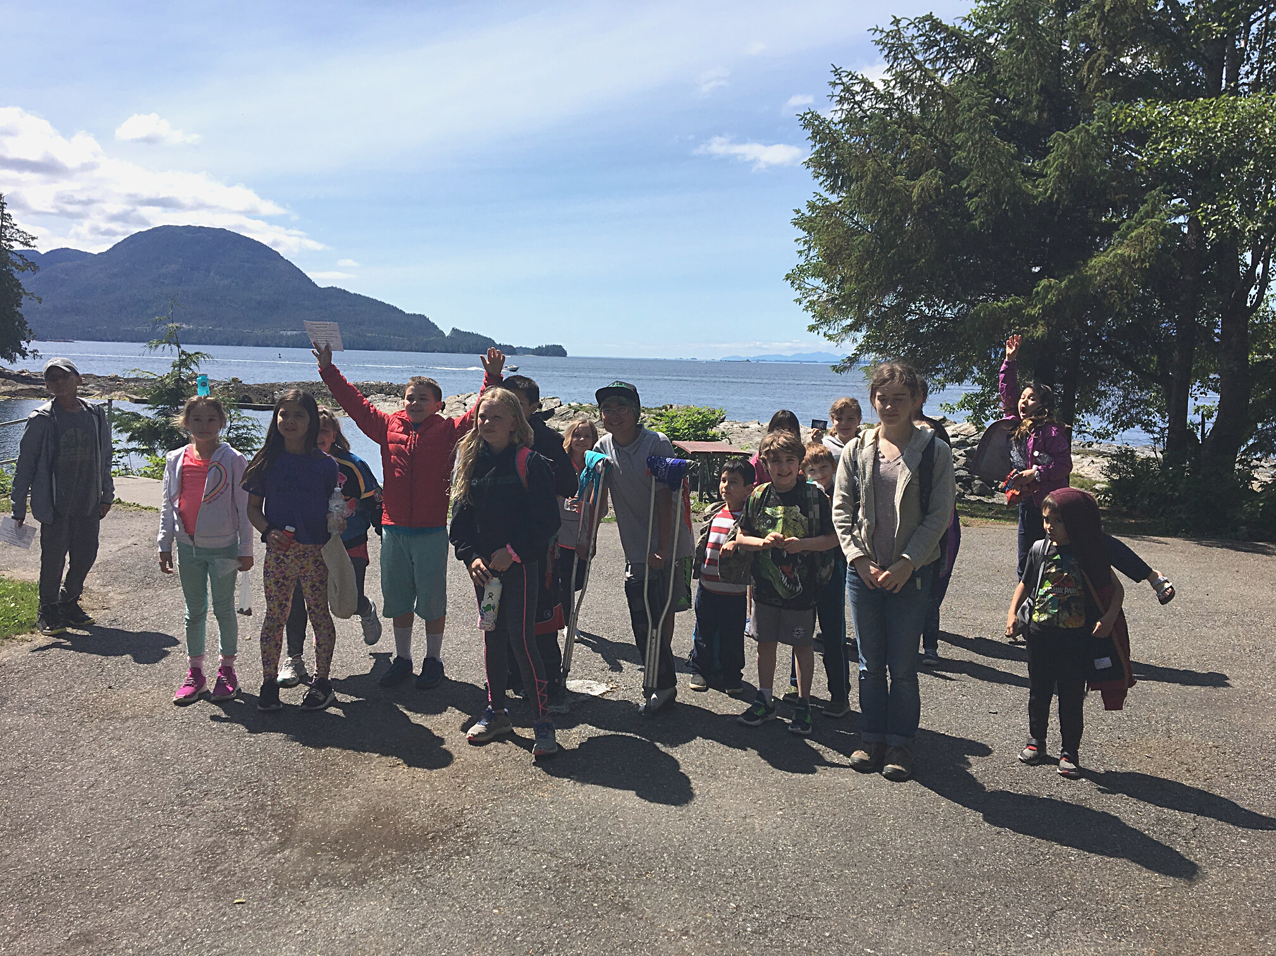
Ketchikan Community Foundation

Slide 12
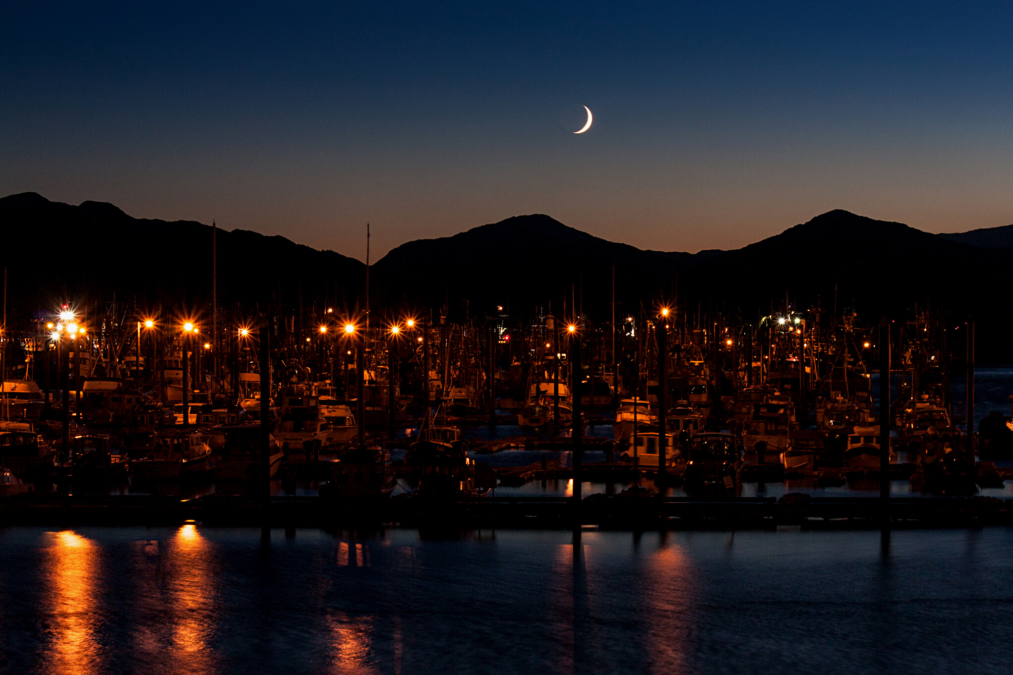
Kodiak Community Foundation
Photo credit: Pam Foreman

Slide 13
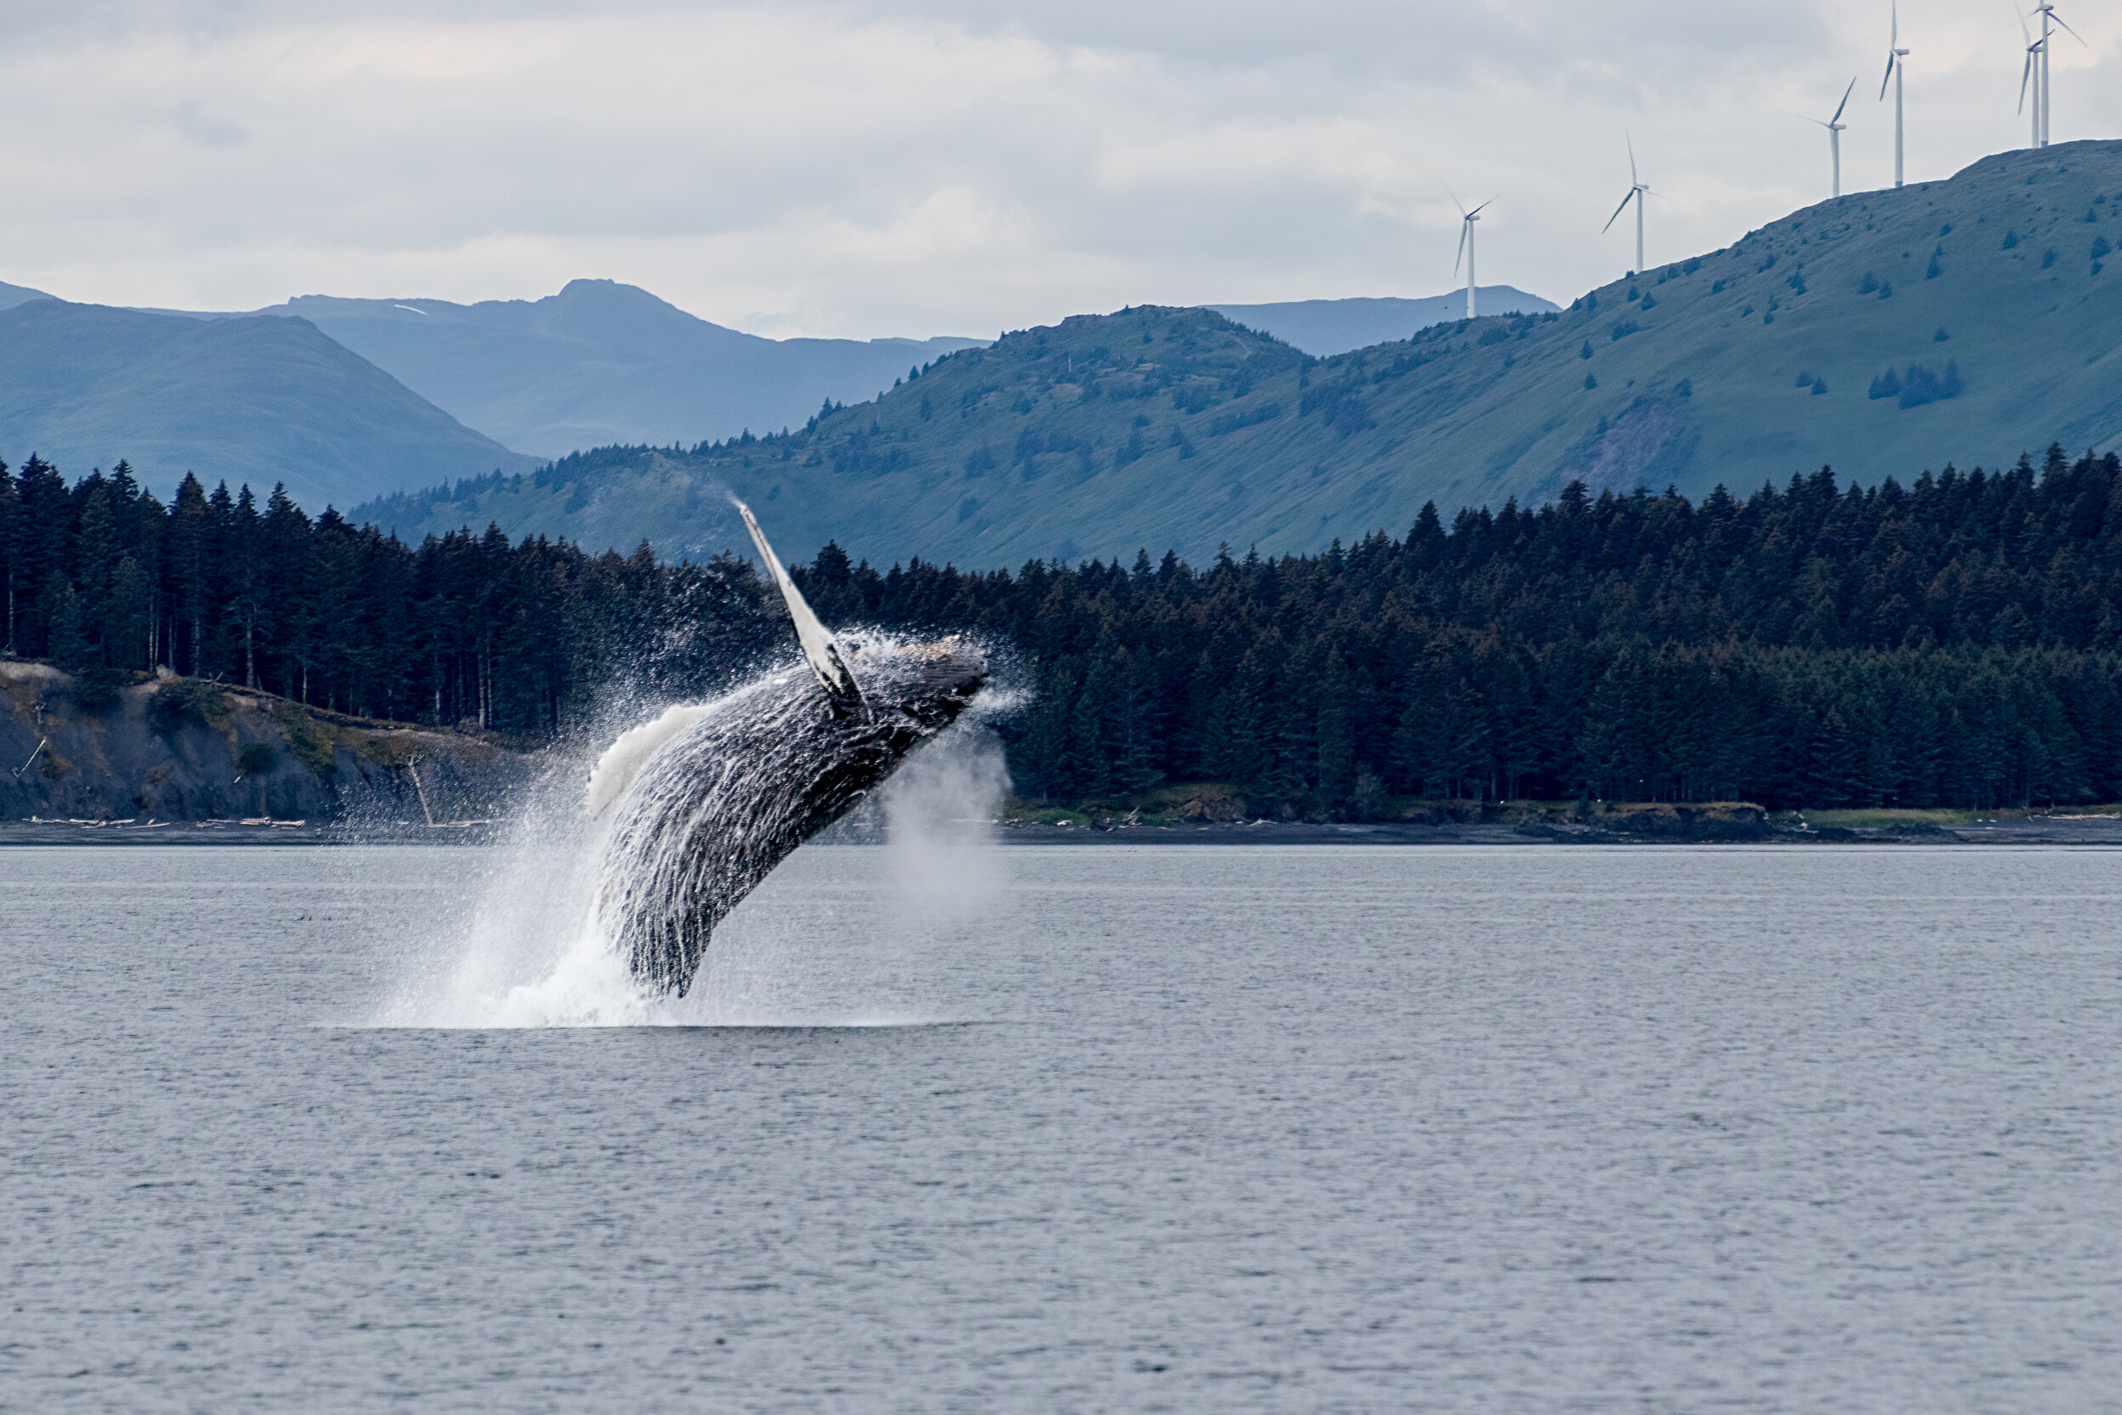
Kodiak Community Foundation
Photo credit: Pam Foreman

Slide 14
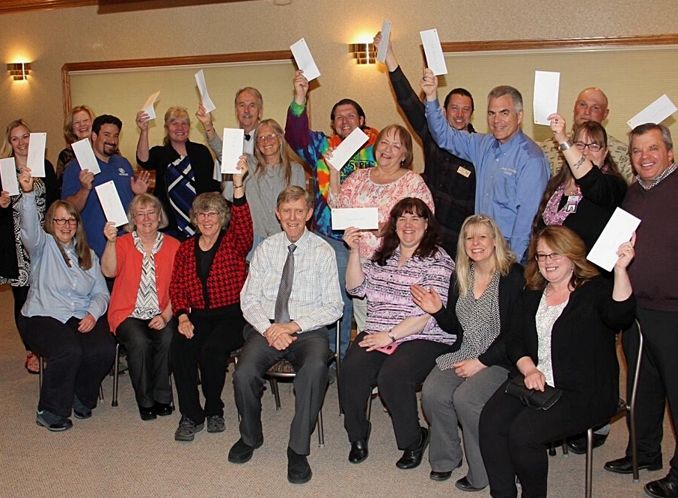
Kenai Peninsula Foundation

Slide 15
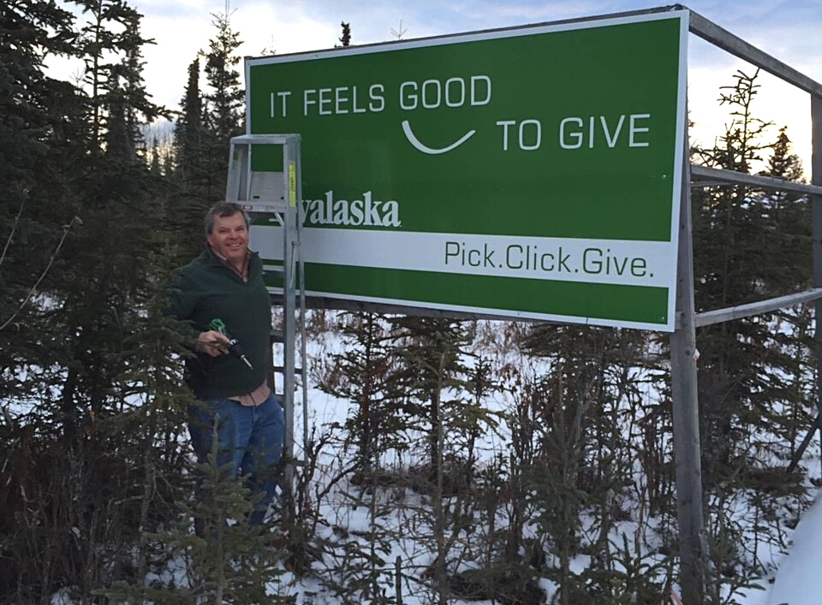

Kenai Peninsula Foundation

Slide 16
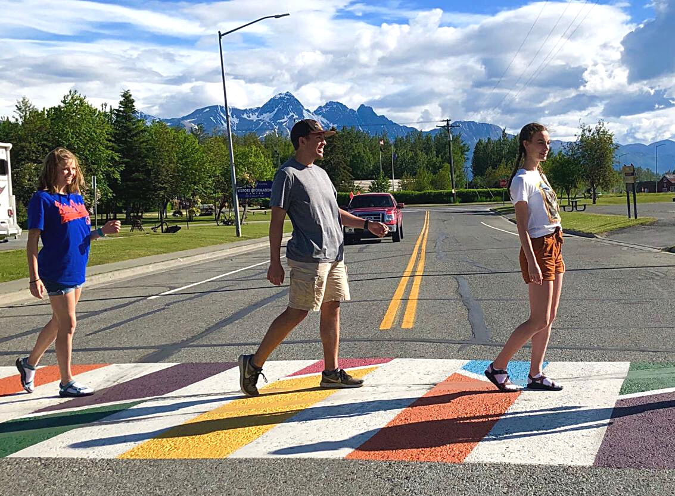
Palmer Community Foundation

Slide 17
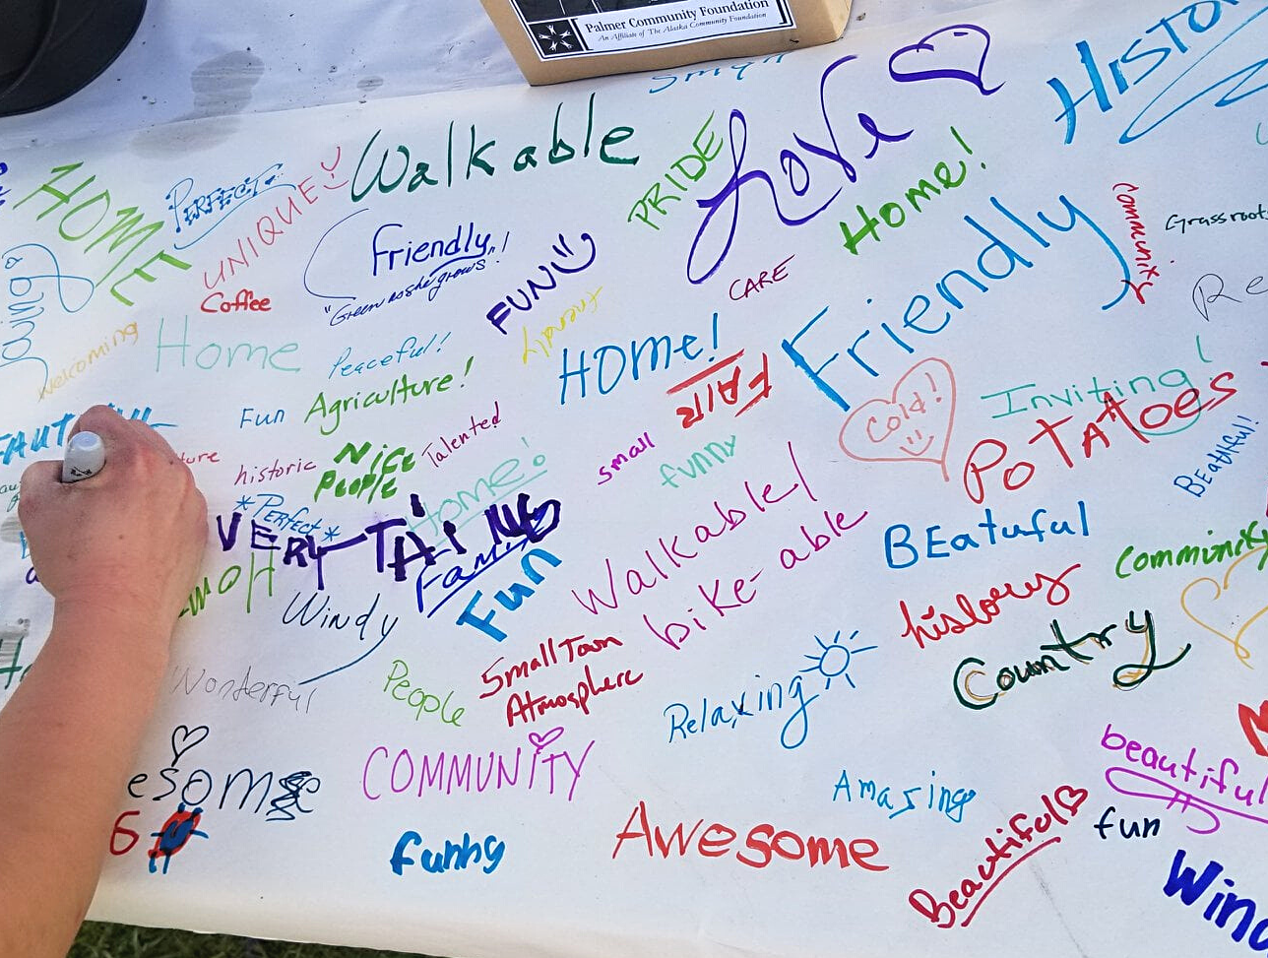
Palmer Community Foundation

Slide 18
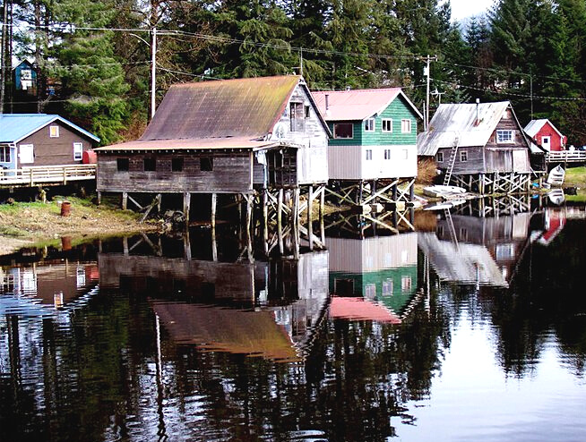
Petersburg Community Foundation

Slide 19
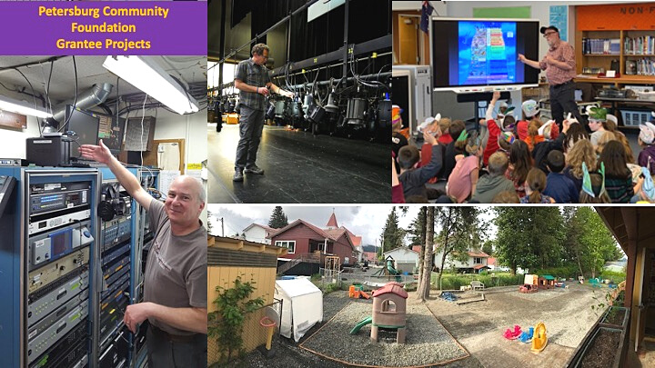

Petersburg Community Foundation

Slide 20
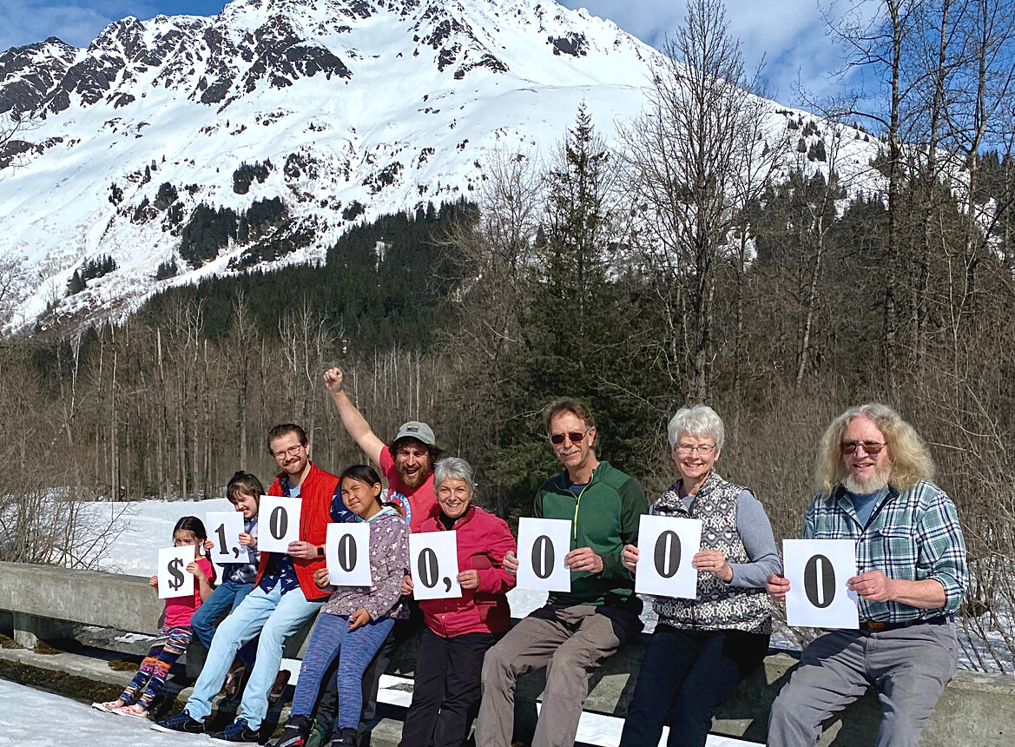
Seward Community Foundation

Slide 21
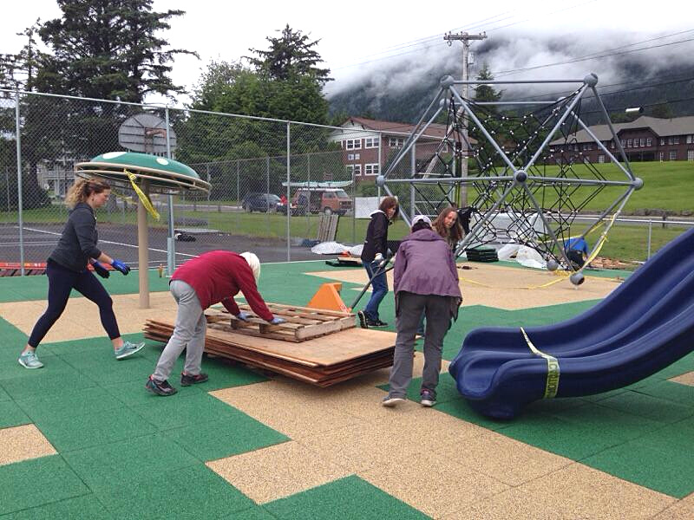
Sitka Legacy Foundation

Slide 22
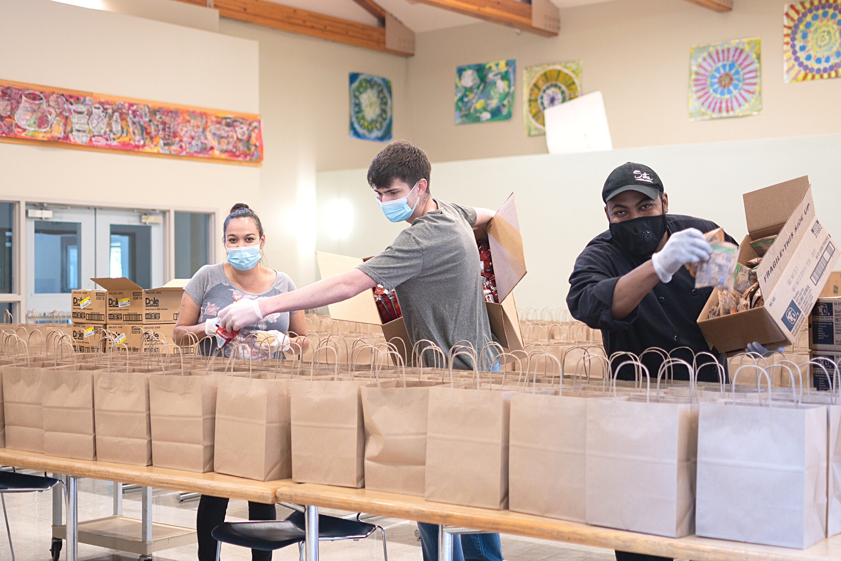
Sitka Legacy Foundation

Slide 23




Affiliates across Alaska
  Golden Heart Community Foundation (Fairbanks & North Pole)
  Jessica Stevens Community Foundation (Upper Susitna Valley)
  Chilkat Valley Community Foundation (Haines & Klukwan)
  Seward Community Foundation (Seward & Moose Pass)
  Kenai Peninsula Foundation
  Kodiak Community Foundation
  Petersburg Community Foundation
  Ketchikan Community Foundation
  Sitka Legacy Foundation
  Palmer Community Foundation
  Cordova Community Foundation

Slide 24


FOLLOW US
FACEBOOK
https://www.facebook.com/AlaskaCF
INSTAGRAM
https://www.instagram.com/akcommunityfoundation/
YOUTUBE
https://www.youtube.com/channel/UCKXe5qknkQJCfy4a88jXVlA

Slide 25




WORK WITH US
WEBSITE
https://alaskacf.org/affiliates/
EMAIL
affiliate@alaskacf.org
CONTACT NUMBER
907-249-6609

